Slide 1
Logistics & Supply Chain Management

Slide 2
Agenda…..
The Supply Chain and Supply Chain Management
Five key SC management concepts:
  ‘one size never fits all’
  Material De-coupling
  Postponement
  Reducing the Lead-time Gap
  Information de-coupling
Logistics and Outsourcing
  Reasons for outsourcing logistics
  3 PL and 4PL service providers

Slide 3


In pairs - map the supply chain:
players, activities, connections, etc
Notes:
Allow 5 mins for students to work in pairs to map out the supply chain for a typical breakfast. Pick any products your students might be familiar with.
Ask students to consider:
The physical aspects of the chain
Key activities in the supply chain
Think ‘network’ not just a ‘chain’
Allow another 5 mins for discussion – ask students what they have included. Should go well beyond first teir suppliers and also consider utilities, farming equipment and OEMs/MRO functions. Fuel supply chain for trucks/manufacturing/utilities; packaging supply chain; etc.

Slide 4
Customs & Excise
Internet online ordering telephone mobile phone
Truck
Supermarket Distribution Centre
Cupboard
Supermarket
Car
Kellogg's Manufacturer
Road Tanker
Port
Petrol
Ship
Port
Truck
Bowl
Money
Pipeline
Truck
Refinery
Mill
Farm
Truck
Spoon
Port
Combine Harvester
Sugar
Ocean Tanker
Manufacturer of Harvester etc …..
Port
Pipeline
Oil Field etc
Radio, Electric light , central heating , gas, TV , water and sewage……………..etc
Notes:
Hidden slide – do not print before the lecture.
Reveal after discussion on previous slide.

Slide 5
Supply ‘chains’ are in fact complex ‘networks’
upstream
downstream
Competing firms
Competing, interconnected supply networks
3rd tier suppliers
2nd tier suppliers
1st tier suppliers
Focal Firm
1st tier customer
2nd tier customer
End consumers
Interconnected competing supply networks
Notes:
Refer to textbook

Slide 6
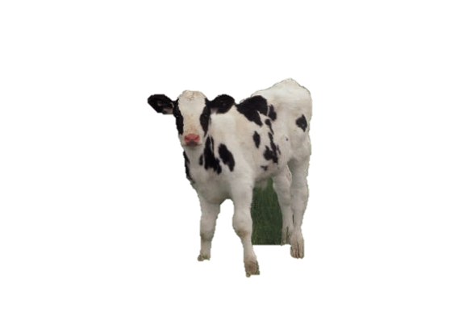

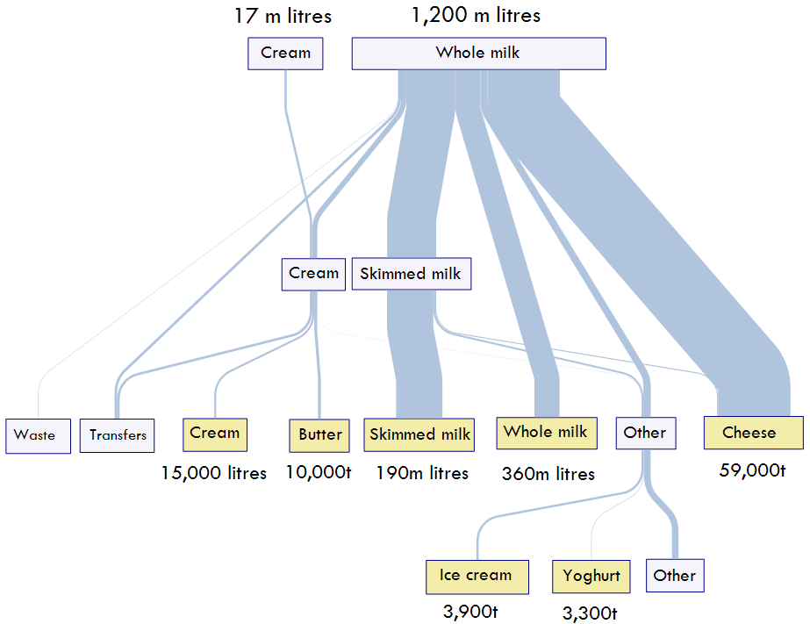
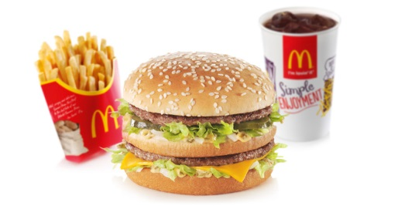
Networks, not supply chains
What else?
Adapted from: http://www.scotland.gov.uk/Publications/2011/02/22152837/0
Notes:
Hidden slide – reveal in lecture
Milk whey is used to make cheese.
Milk also used to make ice cream, yoghurt and many other products – e.g. as an ingredient in sauces, cakes, etc.
Dairy cows need to have calves to keep on producing milk – any male calves - typically end up in burgers!!
Foot and Mouth disease in the UK (2002) had a significant impact on all supply chains that use beef or any by product of ‘cow’, e.g. leather, dairy and meat. The long term consequence has been an increase in regulation (traceability of beef products) and hence an increase in the cost of beef, etc.

Slide 7
The Supply Chain encompasses…..
“……..all activities associated with the flow and transformation of goods from raw materials stage (extraction), through to the user, as well as the associated information flows.
Material and information flow both up and down the supply chain.”
Handfield and Nicholas, (1999), p. 2.
Notes:
Discuss this definition.
Material AND information flow.

Slide 8
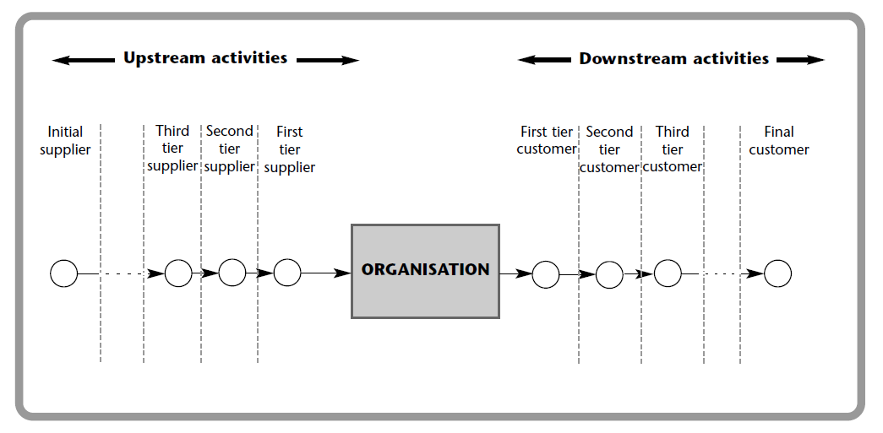
The end-to-end supply chain
Primary manufacturers
Focal firm
End customers
Purchasing
and supply
Physical
distribution
Supply side
Demand side
Supply Chain Management
Source: Waters (2002) and Harrison & van Hoek (2002)
Notes:
Lots of terminology to introduce:
Upstream – downstream
Supply side – demand side
Etc.

Slide 9
Supply Chain Management is..
“……the integration of these activities through improved supply chain relationships, to achieve a sustainable competitive advantage.”
Handfield and Nicholas, (1999), p. 2.
Notes:
Emphasis on ‘integration’ and sustainable competitive activity.
Good time to make the point that “SCs compete not individual companies” ( Martin Christopher)

Slide 10
Achieving an integrated supply chain
Stage One: Baseline
Purchasing
Manufacturing
Distribution
Marketing
Customers
Baseline organisations are characterised by:
  Functional silos
  Adversarial relationships
  Sub optimisation
  Independent planning by function
Baseline performance leads to:
  High total costs
  Poor service
  High inventory

Slide 11
Functional Silos
Production
Sales & Marketing
Purchasing
Distribution
Products
Customers
Products
Customers
Products
Customers

Slide 12
Achieving an integrated supply chain
Stage One: Baseline
Purchasing
Manufacturing
Distribution
Marketing
Customers
Stage Two: Process and systems Integration
Materials
Management
Operations
Marketing
Customers
Stage three: External Integration
Suppliers
Internal Supply
Chain
Customers
Stage 3 organisations are characterised by:
  Cross-functional and cross-organisational collaboration
  ONE shared and agreed PLAN
  Transparent and easily accessible data (cloud technology)
Stage 3 performance leads to:
  Optimised operating costs
  Better availability & responsiveness
  Reduced inventory

Slide 13
From Functions to Processes: creating an integrated ‘supply chain’ within the company
Production
Sales &
Marketing
Purchasing
Distribution
Products
Customers
Products
Customers
Products
Customers

Slide 14
From a Single company to a Supply Chain perspective
Manufacturer
Retailers
Suppliers
Wholesalers
Products
Customers
Products
Customers
Products
Customers
“Supply Chains compete not individual companies” Martin Christopher
Notes:
Inter-organisational integration / process alignment!! What SCM is all about.
Not many companies achieve this.

Slide 15
The goal of SCM is:
“….to manage upstream and downstream relationships with suppliers and customers in order to create enhanced value in the final market place at less cost to the supply chain as a whole.”
(Prof. Martin Christopher)
Single company
(functional) thinking
Focus on the customer
Increase own profits
Consider own costs
Guard ideas, information and resources
Improve internal process efficiency
Supply Chain thinking
Focus on the ultimate consumer
Increase profits for all
Consider total supply chain costs
Share ideas, information and resources
Improve joint process efficiency
(Source : A.T. Kearney)

Slide 16
Designing a Responsive Supply Chain
Five Key concepts:
Differentiate - ‘One size never fits all’: Segment /prioritise the product /customer base and design the best supply chain for each;
De-couple the supply chain: between Lean (push) and Agile (pull) processes; place strategic inventory at the decoupling point;
Postpone: delay adding value wherever possible (form and place postponement);
Reduce the Lead-time Gap: work to reduce the gap and become less reliant on finished product forecasts;
Use real-time demand data: make real-time demand available upstream at the information de-coupling point, and use it to make supply & production decisions;

Slide 17
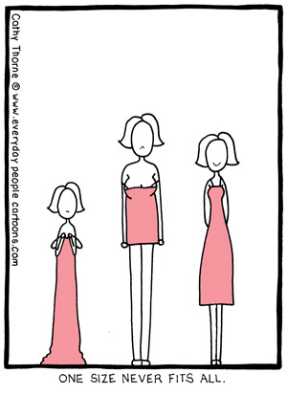
1. A differentiated supply chain strategy
When there are different products with:
  different characteristics
    e.g. demand volatility/ value / volume / weight / shelf-life / criticality, etc.
  different service requirements
    e.g. lead-time / delivery frequency / order quantities, etc.
Managers need to decide
……….what is the right supply chain for each product-customer segment?
“One size never fits all”

Slide 18
E.G. Consider demand volume ….
80%
Agile
% of total
demand
Forecast for capacity, execute to demand
Make to order
High priority in production schedule
Hold inventory in generic form
Lean
Make & distribute to forecast
Low priority in production schedule
Focus on efficiency
Seek economies of scale
20%
% of products

Slide 19
Two Supply Chain strategies
(NOT mutually exclusive!)
Lean
“having no surplus flesh or bulk”
Waste elimination
Robust processes
Minimisation of inventory and WIP
Cost transparency in the supply chain
Multi skilled workers
Reduced change-over times
Continuous improvement
Physically Efficient
Agile
“quick in movement : nimble”
Quick response -velocity
Flexible processes
Customised service
End-to-end Visibility
Postponement of final configuration
Synchronised with true demand
Value creation
Market Responsive
Notes:
The ability to respond rapidly to
changes in demand.
“ Agile competition demands that the processes that support the creation, production and distribution of goods and services be centred on the customer-perceived value of products.
Successful agile companies, therefore, know a great deal about individual customers and interact routinely and intensively”

Slide 20
Consider demand volume and variability
High
“Agility” is needed in
less predictable
environments where
the demand for variety
is high.
“Lean” works best in
high volume, low
variety and predictable
environments.
AGILE
Product Variety/
Demand Variability
LEAN
Low
Low
High
Volume Sales
(Christopher, 2011, pp 100)
Notes:
Hidden slide – do not print.
Reveal during the lecture.

Slide 21
Demand and supply characteristics determine SC strategy
Functional and Innovative Products
“Before devising a supply chain, consider the nature of the demand for your products.”
 | Functional | Innovative
Demand | Predictable & steady | Unpredictable & variable
Product Life Cycle | > 2 years | 3 months to 1 year
Contribution Margin | 5% to 20% | 20% to 60%
Product Variety | low | high
Forecast error at time production committed | 10% | 40% to 100%
Average stock-out rate | 1% to 2% | 10% to 40%
Average end-of-season markdown (%full price) | 0% | 10% to 25%
Lead Time | 6 months to 1 year | 1 day to 2 weeks
SC strategy | Physically Efficient | Market Responsive
Source: Fisher (1997) What is the right Supply Chain for your Product? HBR.
Notes:
Differences in Demand
The aim is to reduce market mediation costs (lost sales, forced mark-downs) through increased supply chain speed and flexibility
That impacts on the physical structure of the supply chain I.e. where should I source a product or locate my factory and warehouses.
To become more market responsive – there is the need to focus aggressively on reducing lead-time – this clearly impacts on decisions about network design
Whereas the aim with regards functional products is to supply the product at minimum cost so LT would be reduced as long as it doesn’t increase cost.

Slide 22
“One size does not fit all”
Functional and Innovative Products
Functional products
Innovative products
Efficient
Supply Chain
match
mismatch
Responsive
Supply Chain
mismatch
match
Source: Fisher (1997) What is the right Supply Chain for your Product? HBR.
Notes:
Companies often find themselves in the top right hand cell.
Fisher argues that for each dollar invested intelligently in improving supply chain responsiveness will usually lead to a decrease in more than a dollar in the cost of stockouts and forced mark-downs that result from this mismatch. Simply because of that high profit contribution.

Slide 23
2. The de-coupling point
Lean
Agile
Forecast driven
Economic batch quantities
Maximise efficiencies
Demand driven
Localised Configuration
Maximise effectiveness
Strategic
Inventory
Notes:
A very important SC concept
Where we separate forecast drive and demand driven processes.
Place strategic – safety stock at the decoupling point.
Most supply chains tend to carry stock in multiple locations due to ownership and issues to do with lack of trust and visibility in the SC.
Ideally we should identify a single decoupling point for each product group or segment.
Ideally the decoupling point should be as far upstream in the SC process as possible – but only as far as the customer and our competitors will allow!! i.e. we must be able to serve the customer within the timescales the customer demands, this is often determined by our competitors – our service offering must be competitive.

Slide 24
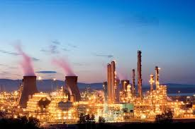
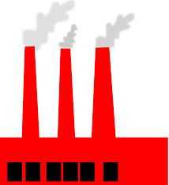
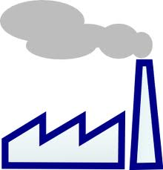
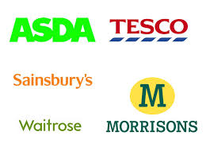
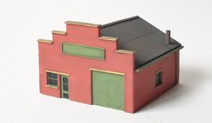
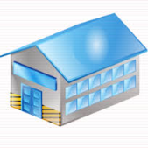
2. De-coupling point
Driven
By
Demand
Driven
Driven
By
Forecast
By
3. Postponement
Delay committing products to particular market segments as long as possible, preferably until firm orders have been received;
Forecast at a generic level and delay final configuration: FORM
Hold stock back in a central location and distribute only when demand is known: LOGISTICAL
Notes:
Another very important SCM concept or strategy – postponement.
Discuss Form and Place (Logistical) postponement strategies and give examples.

Slide 25
Traditional Apparel Business Process
Source
Raw Material
Discount
Sales
Design
(famous designers)
Produce
100% - Far East
Distribute
(sea-freight)
Retail
Stores
Industry norm … 6 to 18 months!
Zara’s supply chain (lean AND agile strategies; design postponement)
Postpone design
Differentiate
2-3 weeks
Source
Raw
Materials
Design
(new graduates)
Produce
80% - Europe
20% - Far East
Packaging
& Labelling
(Spain)
Distribution
(air & road)
Zara
Stores
Stock Allocation
Sales reports
Market research

Slide 26
The problem with lead-time
SOURCE
MAKE
DELIVER
Supply Chain Lead Time
Longer forecast horizon for planning
  Increased uncertainty
  More inventory buffer needed
More inventory needed in the pipeline
Greater risk of obsolescence (waste)
Deterioration of freshness /quality
Less responsive to sudden change in demand

Slide 27
4. The Lead-time Gap
Make-to-stock
PLAN
SOURCE
MAKE
DELIVER
Supply Chain Lead Time
Lead-Time Gap
Forecast-driven
Customer’s Order Cycle Time
Order Fulfilment
FGI
Most organisations fill the gap with inventory
Decoupling point /strategic inventory
BETTER
to reduce logistics lead-time
and extend customer order cycle by
immediate use of information
Notes:
Customer order Cycle – depends on how long the customer is prepared to wait – that usually depends on the product and the service being offered by competitors.
It means you have to forecast demand and because forecasts are never accurate the company has to carry inventory at a cost to the business

Slide 28
Compress time and reduce the LT Gap
Make-to-order
Less dependent on forecasting
Forecast at a generic level
Reduce complexity of planning
Improve service
Reduce inventory
More responsive to the market
PLAN
SOURCE
MAKE
DELIVER
Supply Chain Lead Time
Lead-Time
Gap
Customer’s Order Cycle Time
Order Fulfilment
RM
Decoupling point /strategic inventory
Notes:
Reduce delivery lead-time and increase frequency of production (i.e. become more agile) –reduce overall Logistics lead-time and shift decoupling point further away from the customer. Strategic inventory now in a lower value generic state. Forecast for capacity and execute against demand!

Slide 29
5. The information de-coupling point
Forecast Driven
Demand Driven
Less uncertainty due to enrichment of undistorted data
Material
de-coupling
Point 1
Riskpool
Push
Lo volume / Hi uncertainty
Pull
Material
de-coupling
Point 2
regional
stock
Push
Hi volume / Lo uncertainty
Pull
FGI
Distribution
FGI
Local delivery
Suppliers
Production
Retail
Central DC
Regional DC
Information
de-coupling
Point 1
Real-time data
Two key de-coupling points: Material and Information

Slide 30
Case: Dell Computers
1983 – Michael Dell, a medical student, buys out-dated IBM PCs and upgrades them to sell at bargain prices
1987 – Dell Computers build own PCs and sell direct to customers
DELL | Competitor X
Customer -focused | Product-focused
Assemble-to-order | Make-to-forecast
JIT-based manufacturing | Traditional approach
Direct to customers, on-line sales | Sell through traditional channels
11 days total inventory | Several months inventory
Lean & flexible (agile) | Slow to respond
Low risk of obsolescence | High risk of obsolescence
Notes:
Supplementary slide 4 (if you have time)
Explain how the Dell supply chain is what made Dell competitive – not the technology (product) he was selling.
Explain the Dell supply chain.
Remove every second of non-value adding time from the procurement and assembly processes
40% of components delivered on JIT basis
45% local suppliers
Components ordered only when customer-order is received
Components in some cases made to forecast – but its easier to forecast at generic component level than it is to forecast finished customised product
Monitors and speakers direct from suppliers to customers – in Dells inventory or less than one day
Components account for 80% of the cost of a computer, but the all important processor cost drops at about 30% pa, therefore the longer the manufacturer hangs onto it the worse value they become.

Slide 31
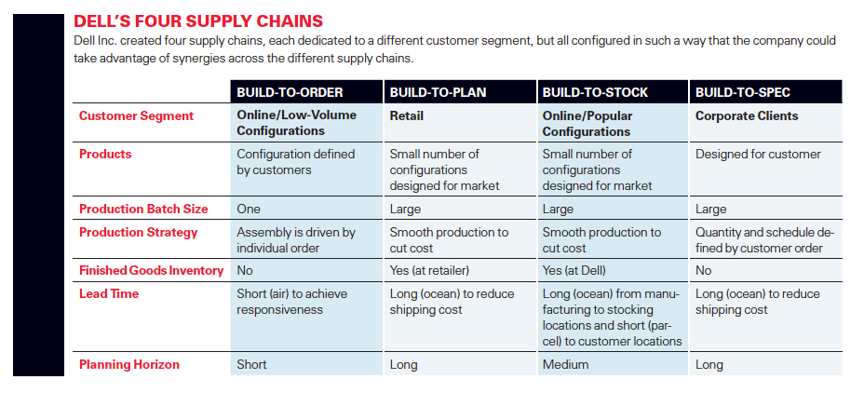
‘One size never fits all’
Source: David Simchi-Levi, Annette Clayton and Bruce Raven , Winter 2013, When One Size Does Not Fit All, MIT Sloan
Notes:
Supplementary slide 5 (if you have time)
More up-to-date detail.
Dell has developed different supply chain solutions for different market segments.
Discuss each.

Slide 32
Designing a Responsive Supply Chain
Five Key concepts:
Differentiate - ‘One size never fits all’: Segment /prioritise the product /customer base and design the best supply chain for each;
De-couple the supply chain: between Lean (push) and Agile (pull) processes; place strategic inventory at the decoupling point;
Postpone: delay adding value wherever possible (form and place postponement);
Reduce the Lead-time Gap: work to reduce the gap and become less reliant on finished product forecasts;
Use real-time demand data: make real-time demand available upstream at the information de-coupling point, and use it to make supply & production decisions;
Notes:
Summary /recap slide

Slide 33
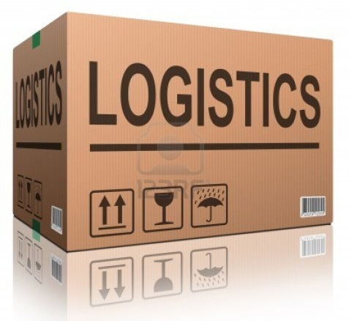
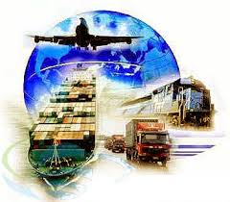
What is Logistics?
‘The process of strategically managing the movement and storage of materials, parts and finished inventory from suppliers, through the firm and on to customers.’ Professor Martin Christopher
‘Logistics is the function responsible for moving materials through their supply chain.’ Donald Waters, Global Logistics, 2010.
Notes:
1. Movement-TRANSPORT & storage & inventory – efficiency of process
Customer is at the heart of the process – focus on meeting customer requirements, TRANSPORT - nothing moves for the sake of movements (derived demand)– velocity i.e. movement in a direction.
2. Logistics is a sub set of SCM
Multi-direction
TACTICAL / OPERATIONAL – LOGISTICS whilst S/Chain is strategic
How customer organise themselves to meet customer needs
Plans, implements, & controls efficient, effective forward & reverse flow & storage of goods, services & related information between point of origin & point of consumption in order to meet customers' requirements

Slide 34
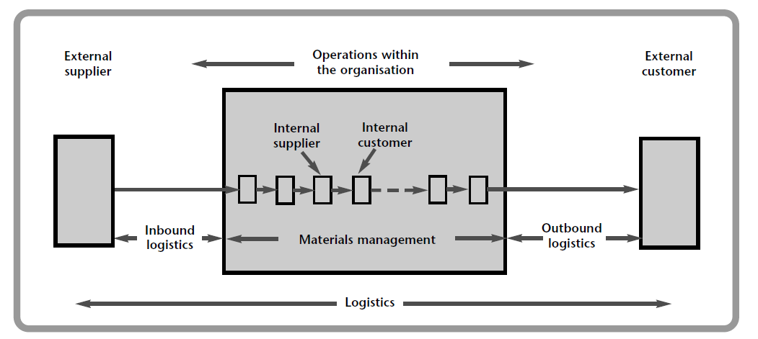
The goal of Logistics
To achieve a target level of customer service at lowest possible cost
Source: Waters (2002)
Warehousing; Materials handling; Inventory; Packaging and Recycling
Freight Transport: inbound and outbound logistics; Information
Notes:
Logistics is a sub set of SCM – movement- customer is at the heart of the process, nothing moves for the sake of movements – velocity i.e. movement in a direction.
Logistics consider wide set of activities dedicated to transformation & circulation of goods, such as material supply for production, core distribution & transport function, wholesale & retail & also provision of households with consumer goods as well as related information flows (Handfield & Nichols, 1999). These activities composing logistics are included into 2 major functions:
physical distribution; (derived transport segment), &
Materials management; (induced transport segment).

Slide 35
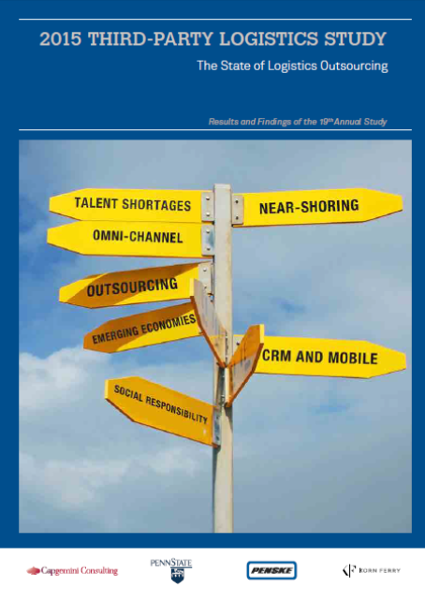
Reasons why companies often Outsource Logistics
  Improve services & Increase flexibility
  Reduce costs: Econmies of scale and scope
  Avoid capital investment & convert logistics from capital to expenditure
  Logistics is a non-core activity, concentrate on core competencies
  Reduce labour costs
  Logistics service providers offer greater logistics expertise
Refer to Langley and CapGemini Annual Third-Party Logistics Study
http://www.3plstudy.com/
Notes:
FOCUS IS NOW LOGISTICS OUTSOURCING
Main findings of the study are that relationships between buyer and supplier, i.e. focal firm and thir-party logistics provider become more and more satisfactory…. Which was the main concern of outsourcing, due to lack of information sharing and goal incongruences.... i.e. 3PL relationships are increasingly popular so there is a positive trend present
Study looks at 500 manufacturing firms in the US
- Positively satisfied with service provider (92%) and successful relationships (98%)
- Increasing use of outsource logistics activities (67%)
- Returning to incourcing remains less prevalent (26%)

Slide 36
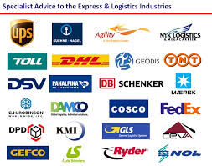
Who are Logistics Service Providers?
Notes:
Why use LSPs? – Specialised knowledge, investment in assets, economies of scale

Slide 37
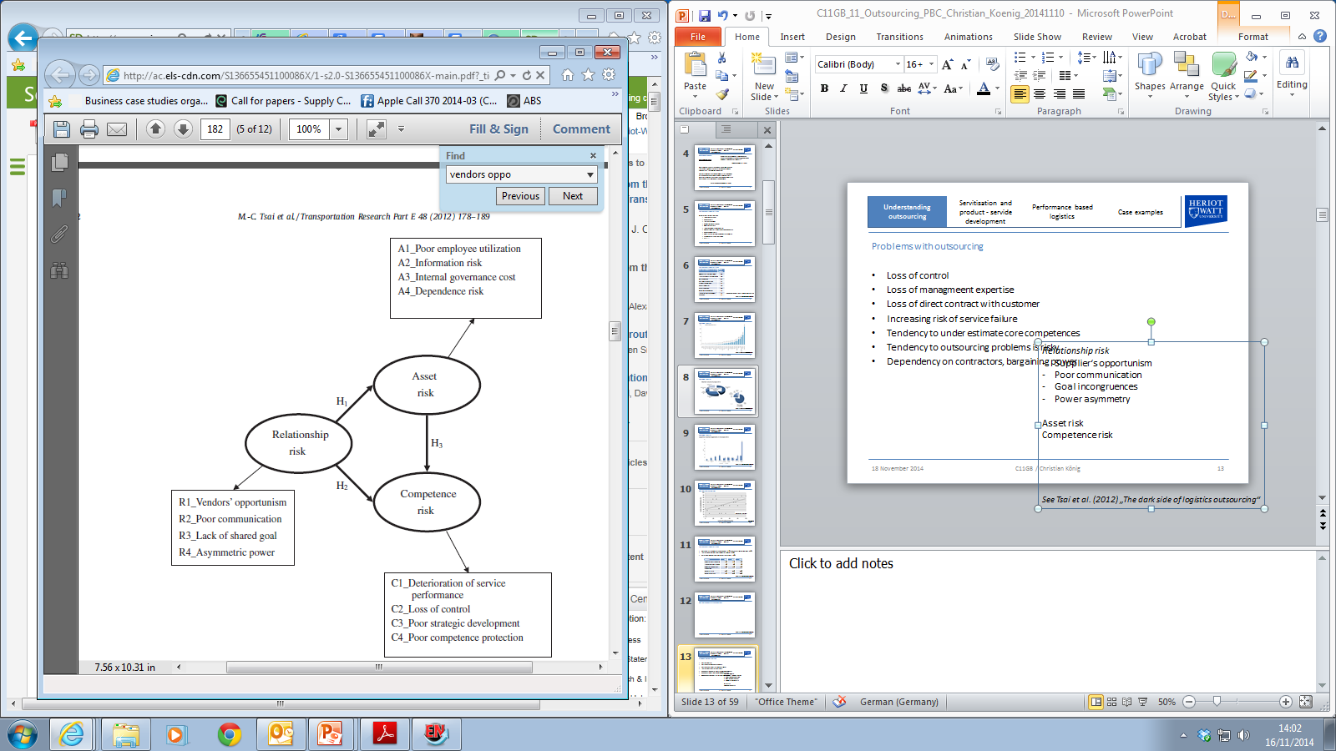
Problems with Outsourcing
  Loss of control over distribution network
  Loss of management expertise in logistics
  Loss of direct contact with customer!
  Increasing risk of service failure
  Tendency to underestimate core competences
  Dependency on contractors
Source: Tsai et al. (2012) „The dark side of logistics outsourcing“

Slide 38
Classifying logistics companies
Typical Services included:
Transportation – air, road, rail, ship
Warehousing
Pick and Pack, Labelling
Light manufacturing /assembly
Vendor managed inventory (VMI)
Inventory management
Spare Parts distribution
Customs clearance
Managing reverse logistics – returns
Recycling of packaging
logistics service providers (LSPs)
  Hauliers or trucking companies
  Freight forwarders
  Couriers
  Integrators (e.g. FedEx, UPS and DHL)
Third Party Logistics Providers (3PLs)
Considerable overlap between the terminology
All companies that provide logistics services are LSPs
LSPs that provide multiple logistics services, often integrated, are third party logistics providers (3PLs)
(adapted from Mangan et al., 2011)
Notes:
3PLS provide multiple logistics services, often in an integrated fashion

Slide 39
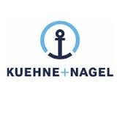


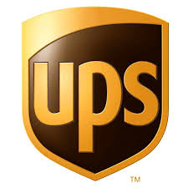
Working with Logistics Service Providers
Two case studies on how service provider improves competitiveness of adidas and nortel networks
http://www.kn-portal.com/fileadmin/_public/documents/material/
KNUCLCS_Nortel_Lead_Logistics_061504.pdf
https://www.ups-scs.com/solutions/case_studies/cs_adidas.pdf
Notes:
Supplimentary slide (if you have time)

Slide 40
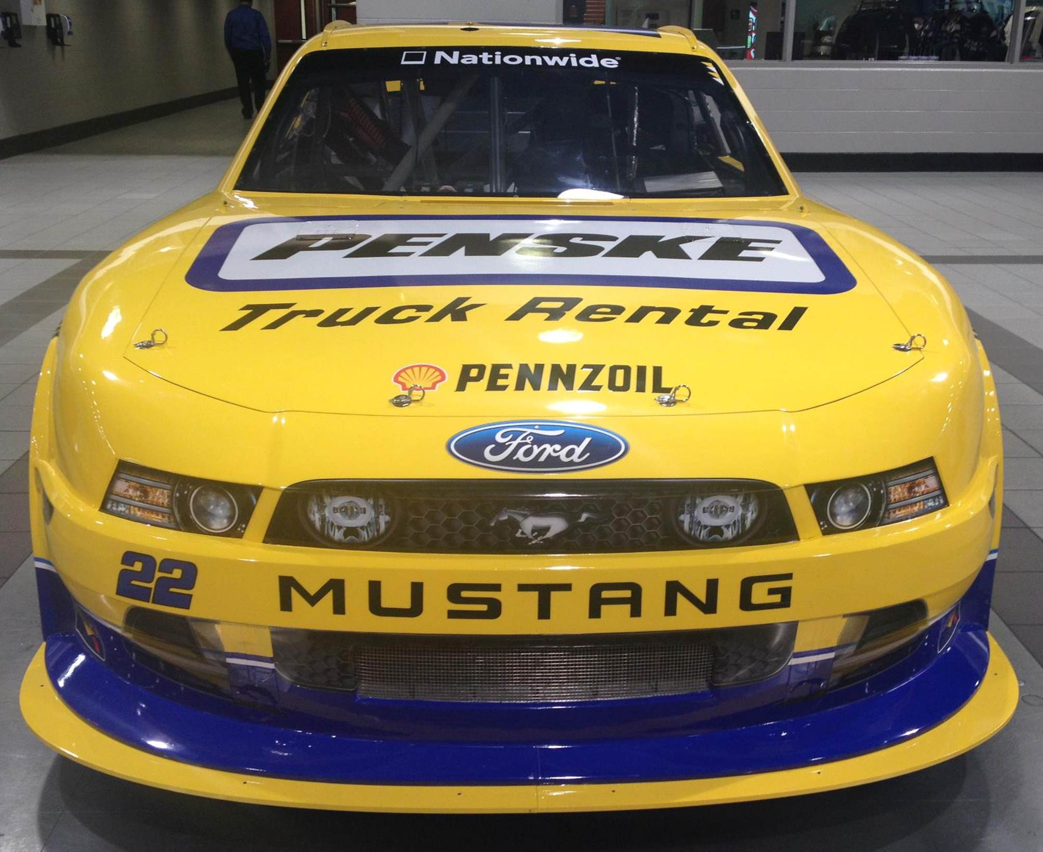
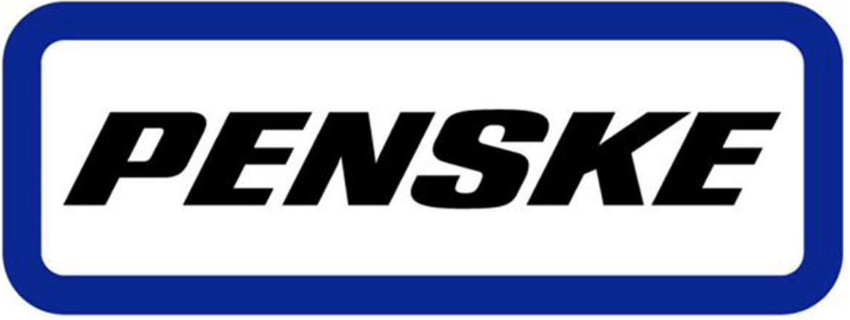
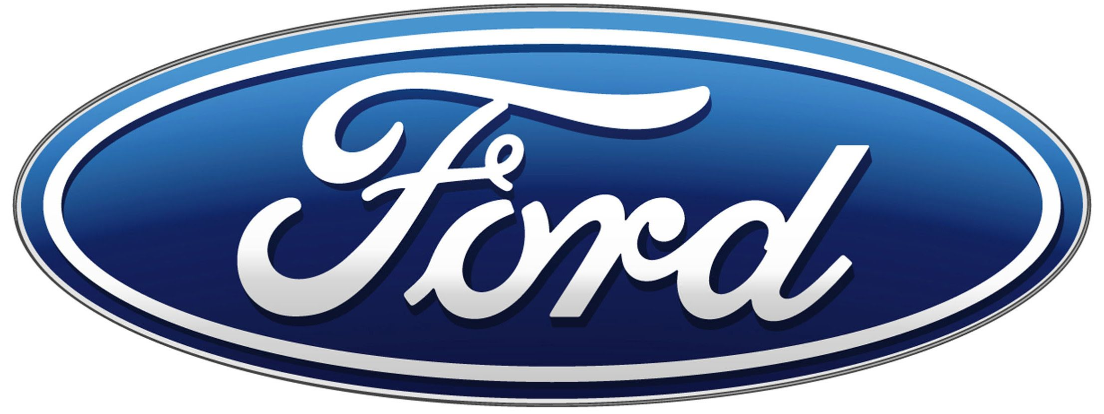
Working with Logistics Service Providers: an example of Strategic Collaboration
Penske - Ford Network Integrator Concept
Winners of the European Logistics Excellence Award 2012

Slide 41
Fourth party logistics (4PL®)
Offering total outsourced supply chain solutions
Originally trademarked by Accenture in 1996
  A supply chain integrator that manages the resources, capabilities and technology of its own organisation, with those complementary service providers, to deliver a comprehensive supply chain solution
3PL and 4PL® are often indistinguishable
Li and Fung Ltd. – often considered equivalent to a 4PL. Hong Kong based traders who ‘orchestrate’ global supply chains.
Li & Fung is a global sourcing firm, that supplies high-volume, time-sensitive consumer goods from an extensive global network of suppliers and distributors.
Growth at Li & Fung
We connect the supply chain to bring our customers the goods they rely on every day

Slide 42
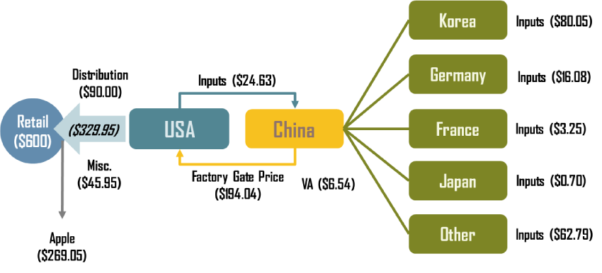
Apple: outsourcing a global value chain
High value-added activities outsourced to developed countries, e.g. Germany. These activities are controlled by firms like ARM Holdings (chip design) and Balda AG (touchscreens).
Marketing support activities are located in the USA .
Routine ‘contract’ manufacturing and assembly outsourced to Taiwaneses firms like Hon Hai Precision Industry (Foxconn factory in Shenzhen).
Relatively complex items, such as chips, are manufactured to design specifications by Samsung in Korea and NXP Semiconductor in the Netherlands.
For each iPhone imported in the United States, its entire factory gate price ($194.04 in this case) is attributed as a trade deficit with China. In reality, only about 3% of the wholesale added value takes place in China
Source: adapted from OECD (2011) "Global Value Chains: Preliminary Evidence and Policy Issues", Organization for Economic Co-operation and Development, DSTI/IND(2011)3, Paris, 2011. http://people.hofstra.edu/geotrans/eng/ch5en/conc5en/iphone_3g_components.html
Notes:
The iPhone is a good example of a product having an international division of production with parts and assembly taking place in several countries. A complex value chain is involved, which creates difficulties in correctly assessing international trade balances. International trade measures the value of exports and imports irrespective of what has happened before to the goods. Even if only a mundane and low value task was performed on a good before being exported, the full commercial value of the good would count as an export. The same applies for imports where their value would be calculated in the trade balance based upon the origin of the goods. The emergence and growing importance of global value chains is thus having a distorting effect on how international trade is measured.
The final assembly and customization of the iPhone takes place at the Foxconn factory in Shenzhen, China, a complex that employs 250,000 workers. Foxconn is a subdiary of the Taiwanese electronics manufacturer Hon Hai Precision Industry Company which specializes in contract manufacturing. For each iPhone imported in the United States, its entire factory gate price ($194.04 in this case) is attributed as a trade deficit with China. In reality, only about 3% of the wholesale added value takes place in China, with the bulk of it concerning Korean and German suppliers (mostly for flash memory and tactile screen). In this case, the product exaggerates the true extent of trade imbalances since the country of origin accounts for a small share of the total added value of the good. By controlling distribution and marketing, Apple is able to capture about 45% of its total value

Slide 43
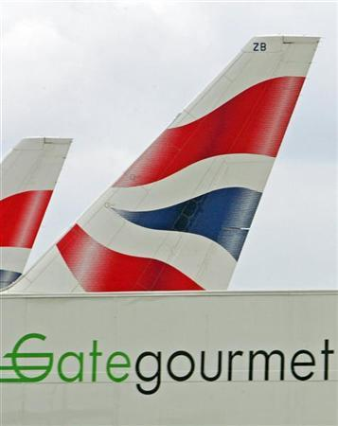
Outsourcing can go wrong!
Lessons to be learned from BA‘s outsourcing
  BA and Gate Gourmet in August 2005
  Outsourcing in-flight catering ?
  Operational costs increased
  Loss of customer loyalty
„The advantages of outsourcing are widely appreciated and, as long as the risks are also carefully considered, it remains a highly effective business strategy.“
http://www.linklaters.com/Insights/Publication1403Newsletter/PublicationIssue20051001/Pages/PublicationIssueItem656.aspx
„If the airline had still been in charge, it would have known the strain and risk to which it was submitting its supply chain“
– anonymous observer
Notes:
Case study that shows how outsourcing can go wrong! Maybe in-class excercise. Let the students read the case first, then discuss.

Slide 44
Final thought: The Supply Chain is the Business
“The complexity of the business is not in the manufacturing, its in the logistics. This is more of a logistics machine than a manufacturing plant.” Bob Beaty, IBM
“Putting cars together is a relatively straightforward exercise. Getting all the parts together at the right place and time with minimum inventory is the real challenge” Production Director, Nissan
“Our focus is on markets and products, but without an effective supply chain we cannot even begin to compete” CEO, Unilever.
“The supply chain is the biggest leverage point we have” (Dell)
“The supply chain is the business model” (Zara)
“Supply Chains compete, not individual organisations” Prof. Martin Christopher

Slide 45
Further Reading:
Christopher, M. (2011), Logistics and Supply Chain Management (4th Edition) Pitman
Rushton, A., Croucher, P. & Baker, P. (2006), The Handbook of Logistics and Distribution Management (3rd Edition), Kogan Page, London
Grant, Lambert, Stock & Ellram (2006) Fundamentals of Logistics Management, European Edition, McGraw-Hill, London.
Key Journals:
International Journal of Physical Distribution and Logistics Management
International Journal of Logistics Management
Supply Chain Management: An International Journal
International Journal of Logistics
Journal of Business Logistics
International Journal of Logistics: Research and Applications

